Slide 1

SAFE South African Financial Education
Empowering Wealth Creation Through Financial Literacy
Presented by Letlhogonolo Kgatshe
September 14, 2025

Slide 2

Home
About
Game
Resources
Gallery
YouTube
Podcasts
Articles
News
Courses
Community
FAQ
Definitions
Contact

Slide 3

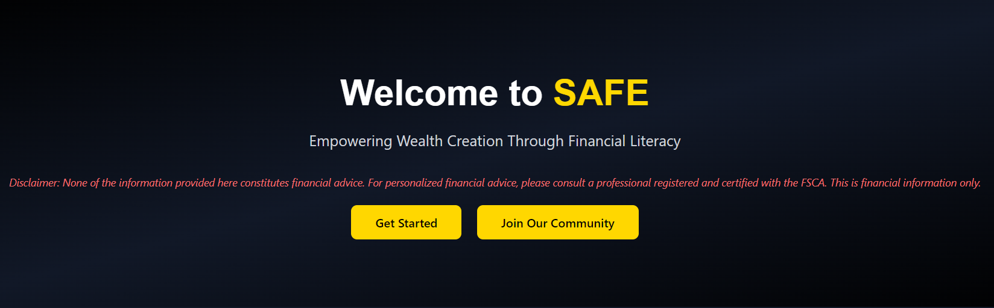
About SAFE - South African Financial Education
At SAFE, we’re dedicated to helping novice investors grow and learn. Financial literacy should be as common as talking about the weather (assuming taking about the weather is commom to you 😂). Our mission is to make financial education accessible by packaging essential information in one place, tailored for beginners and beyond.
We’re not reinventing the wheel—just delivering clear, practical knowledge to empower you. Let’s normalize conversations about portfolios, new listings, and financial goals. Join us, keep an open mind, and let’s grow together, even through the failures.
Our Vision: To make money conversations as casual as asking, “How’s your portfolio looking?” or “Seen any new listings?” Let’s educate ourselves and those around us.

Slide 4
PURPOSE OF SAFE
Last year I started with my financial education I kept running into some issues including but not limited to not finding enough South African content creators who could help, Finding the right beginner information, A roadmap to follow, resources to understand the theory that I was learning, community of like-minded people, people on the same level as I am, mentor to help me avoid mistakes
With all these issues I figures I can and must create a platform that solves all this problems. This project is that . A one stop shop for all beginners
The main purpose is to be the platform I wish I had when I was starting

Slide 5
Problem-Solving & Relevance
Problem: Financial illiteracy is widespread in South Africa, leading to poor money management, high debt, and missed opportunities. ONLY 6% of South Africans get to retire.
Real Need: Novice investors struggle with basics like budgeting, investing, and understanding markets; resources are fragmented and not tailored for SA context.
Relevance: Addresses key issues like high unemployment (33.2% in Q2 2025), inflation (3.5% in July 2025), and low consumer confidence (-10 in Q2 2025).SAFE provides free, accessible education to empower users in a country with economic challenges (GDP growth forecast: 1.7% for 2025).

Slide 6
Impact and Potential
Impact
I want to have is to leave whoever encounters this application better of and informed compared to prior to them see this application.
I want to leave a mark in peoples lives heather they know of my existence or not, I believe that as long as they can get this information I can and will be happy with that much
Potential
I strongly believe that the potential for this information to change peoples lives is immense
The amount of student who could avoid mistakes that could set them back year and thousands

Slide 7
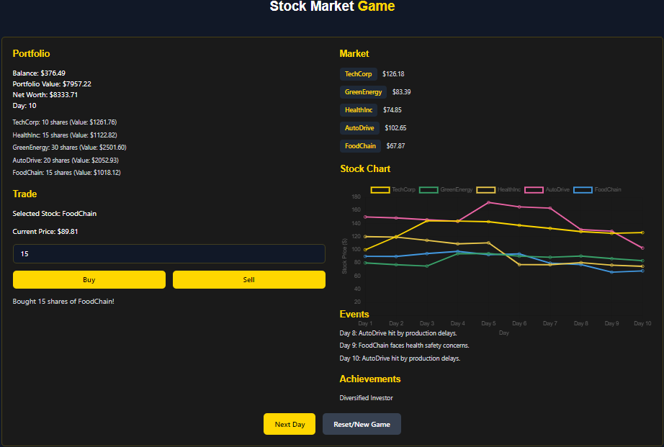
Gamification of Theory: Stock Market Game

Slide 8
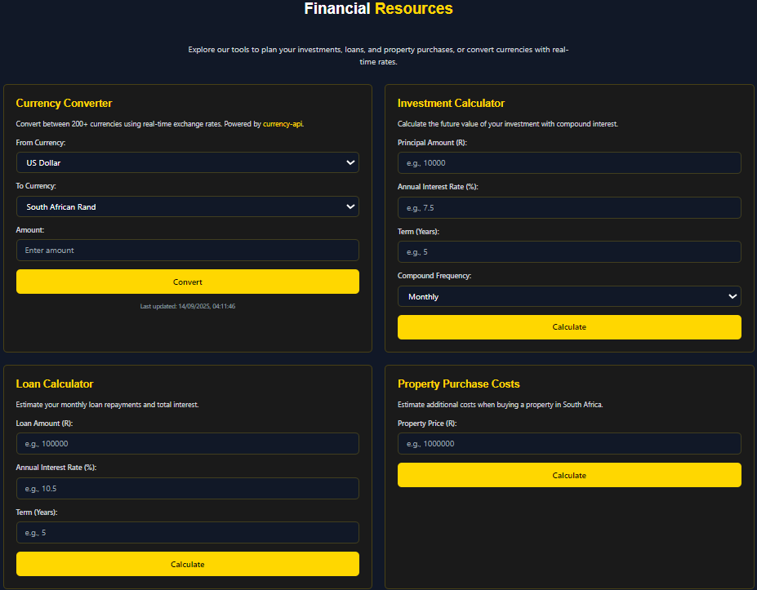

Slide 9
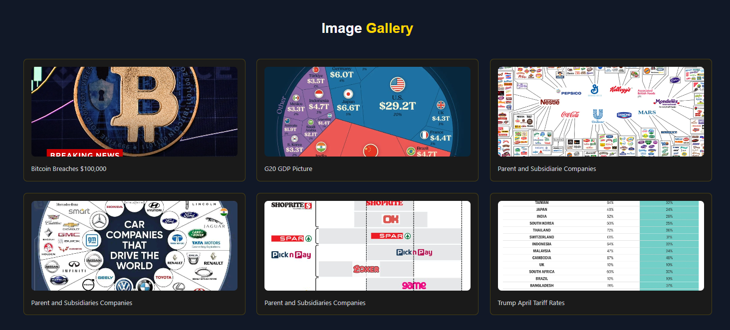

Slide 10
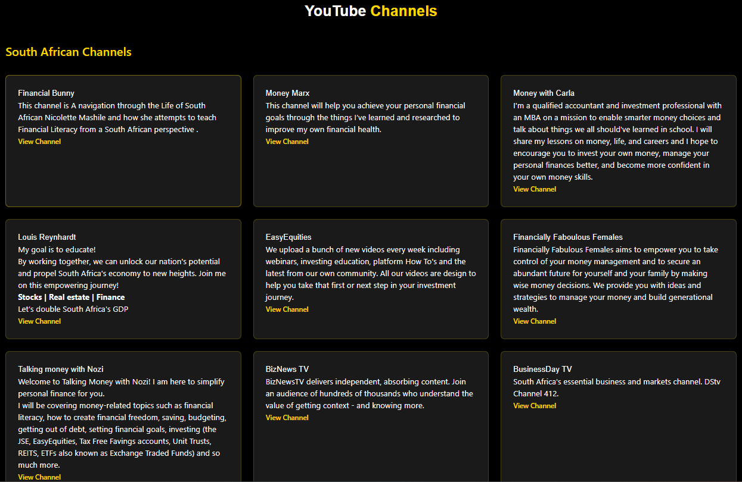

Slide 11
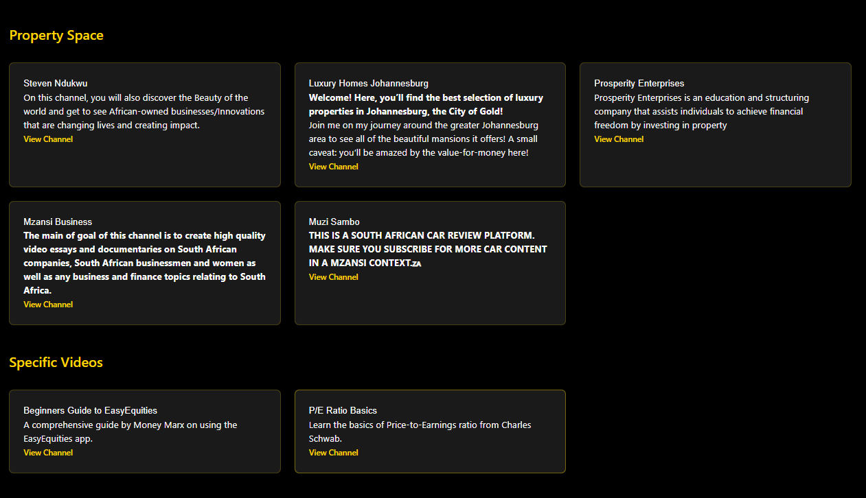

Slide 12
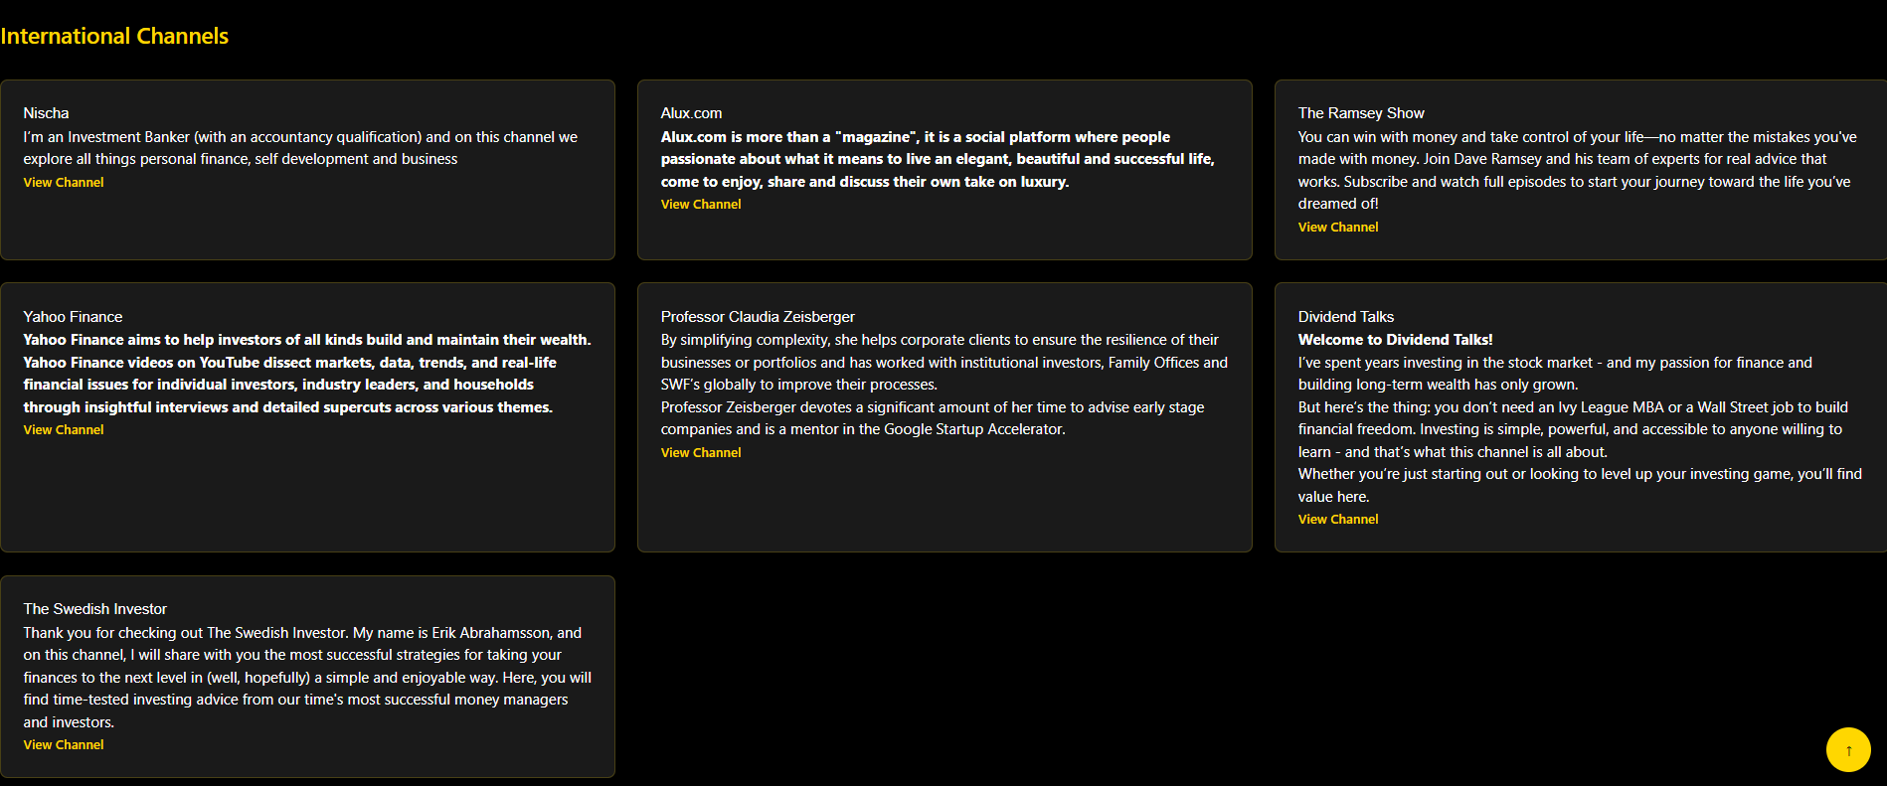

Slide 13
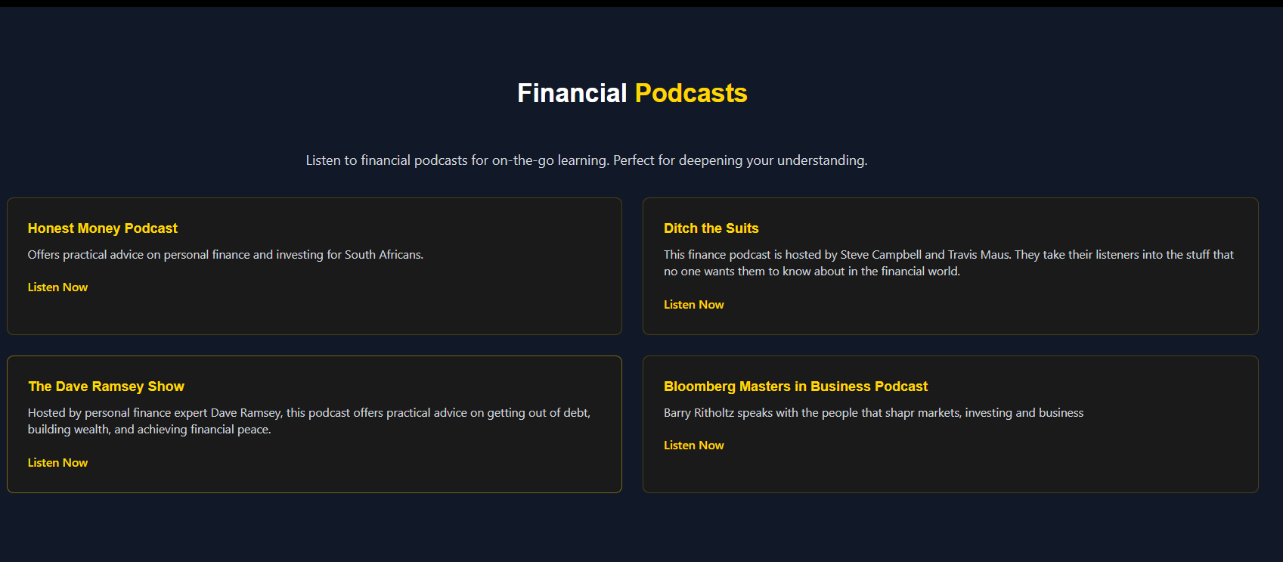

Slide 14
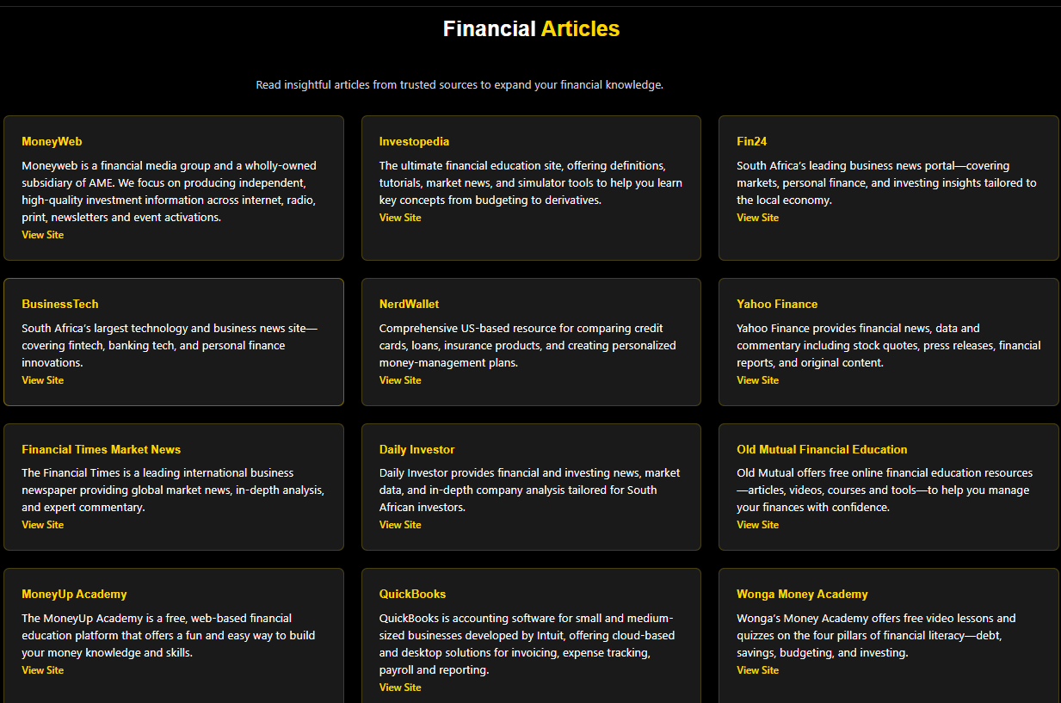

Slide 15
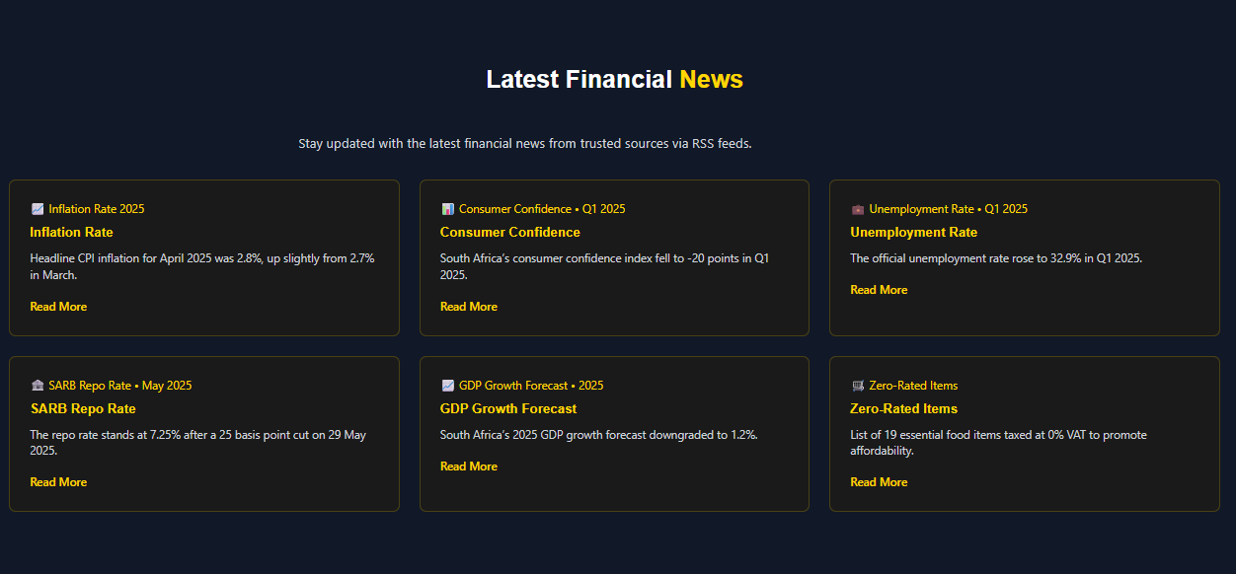

Slide 16
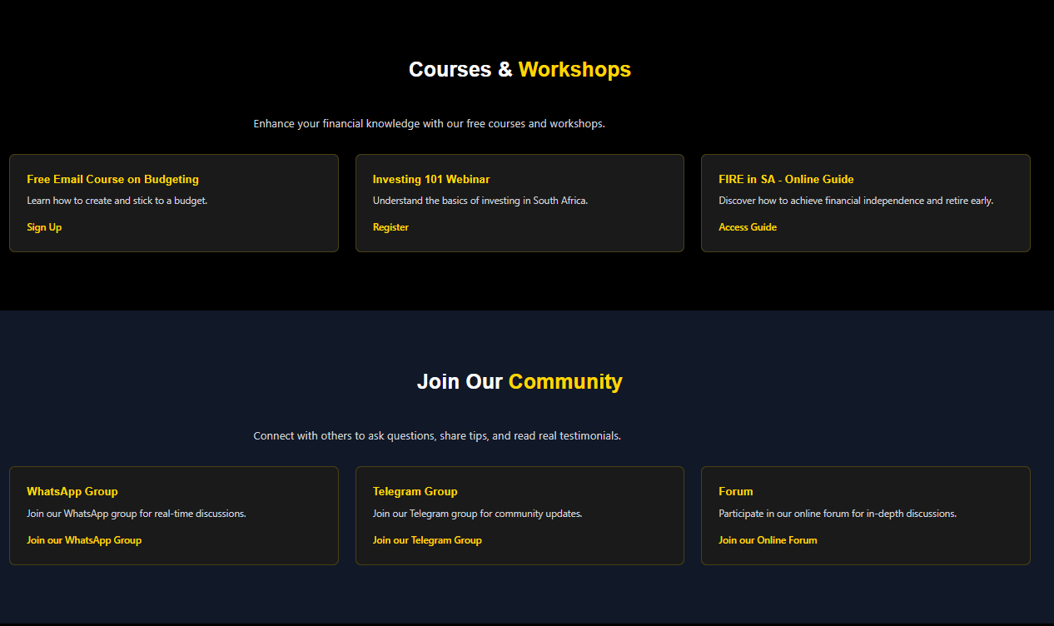

Slide 17
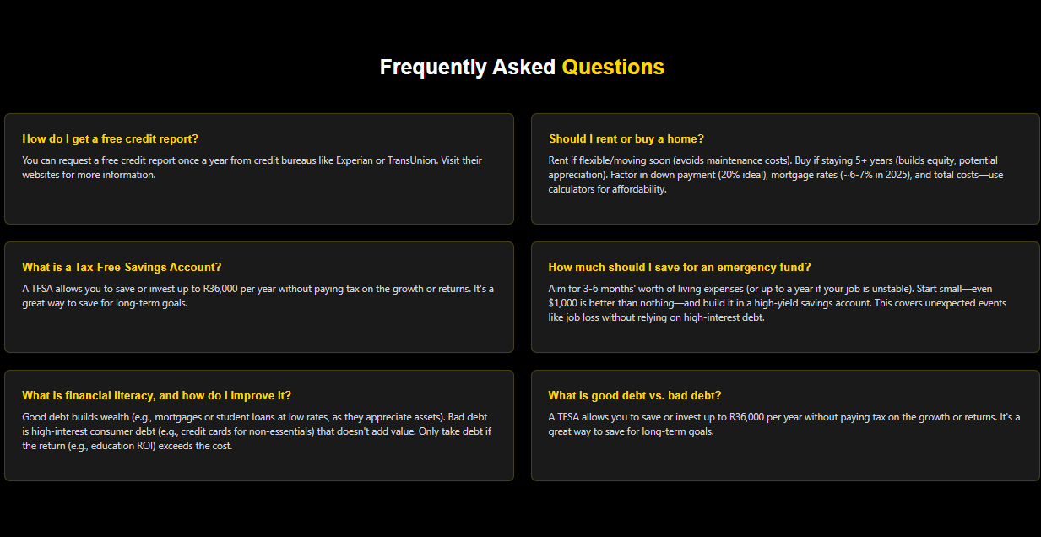

Slide 18
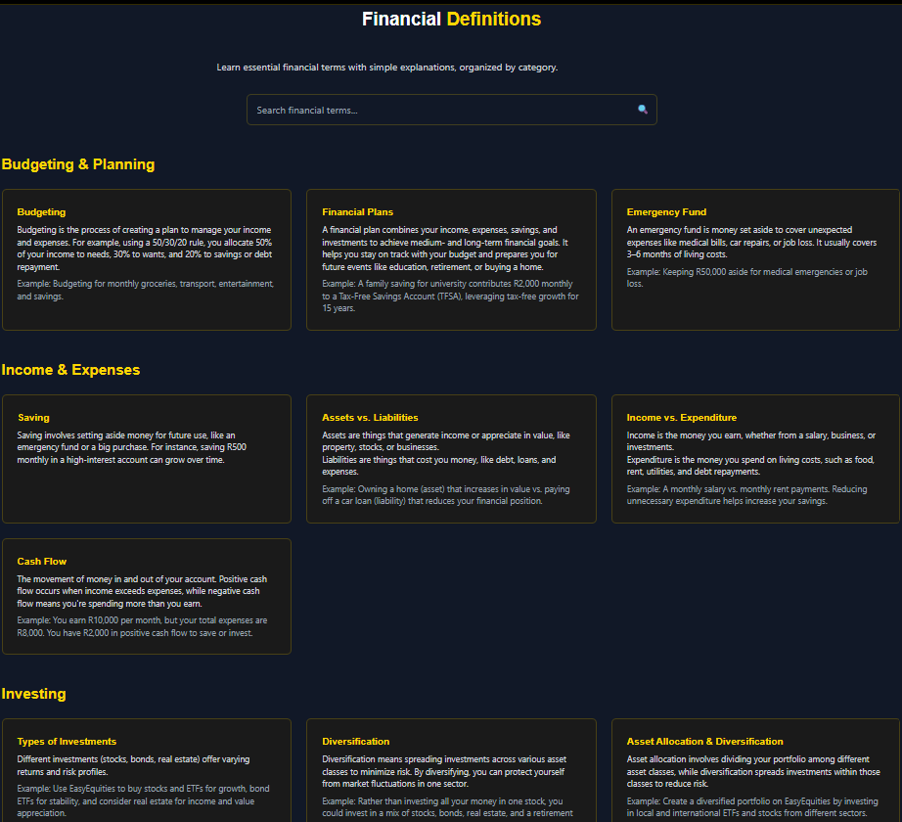

Slide 19
